Slide 1




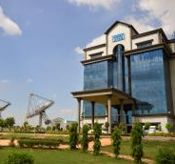



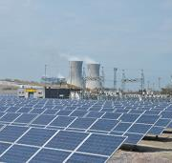


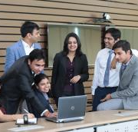
CPPP Workshop
Jan. 04, 2018
GePNIC Implementation at NTPC
– Integration of SAP-ERP with GePNIC
Ajay Kumar
AGM (ERP)
NTPC Ltd.

Slide 2
AGENDA
NTPC at a Glance
e-Procurement in NTPC
Transition to GePNIC
Integration of GePNIC with SAP-ERP
Journey so far & road ahead
Suggestions for further enhancement

Slide 3
AGENDA
NTPC at a Glance
e-Procurement in NTPC
Transition to GePNIC
Integration of GePNIC with SAP-ERP
Journey so far & road ahead
Suggestions for further enhancement

Slide 4
NTPC at a Glance
  NTPC - India's largest power company, set up in 1975
  Became a Maharatna company in May 2010
  Operates 49 stations (Thermal, Hydro, Solar, Wind) spread across the country with a total installed Capacity of 51,383 MW and total workforce of approx. 22000
  12th largest power utility globally. Ranked no. 2 IPP in the world by PLATTS.
  Generates approx. 24% of total power generation in India with 17.7% of installed capacity
  Has embarked on plans to set up 10000 MW green power by 2022 and become a 1,30,000 MW company by 2032

Slide 5
AGENDA
NTPC at a Glance
e-Procurement in NTPC
Transition to GePNIC
Integration of GePNIC with SAP-ERP
Journey so far & road ahead
Suggestions for further enhancement

Slide 6
e-Procurement in NTPC
  Approx. 18000 tenders published every year
  Annual procurement budget of approx. Rs 10000 Cr for materials and services by its projects
  Centralised annual project procurement by Corporate Contracts to the tune of Rs 25000 Cr
  Around 500 procurement specialists handling the above procurement across organization
  Total vendor base – About 89000

Slide 7
e-Procurement in NTPC
  A legacy WIPRO solution was implemented across the organization for e-procurement
  Subsequent to implementation of ERP in 2007, SRM module was launched in NTPC replacing WIPRO solution.
  NTPC has now moved to GePNIC for its e-procurement activities
  For last 3 consecutive years value wise more than 98% and number wise more than 85% of all procurements are being routed through e-tendering mode
  Selective reverse auctions (150-200 per year) are conducted which has resulted in substantial savings to the company.

Slide 8
AGENDA
NTPC at a Glance
e-Procurement in NTPC
Transition to GePNIC
Integration of GePNIC with SAP-ERP
Journey so far & road ahead
Suggestions for further enhancement

Slide 9
Transition to GePNIC
  NTPC decided to shift its e-tendering activities from SRM module of SAP-ERP to GePNIC platform to take care of the following:
  End of product life cycle of SRM 5.5
  Wide acceptability of GePNIC among the bidder community
  Adherence to Govt. and CVC guidelines
  STQC compliance

Slide 10
AGENDA
NTPC at a Glance
e-Procurement in NTPC
Transition to GePNIC
Integration of GePNIC with SAP-ERP
Journey so far & road ahead
Suggestions for further enhancement

Slide 11

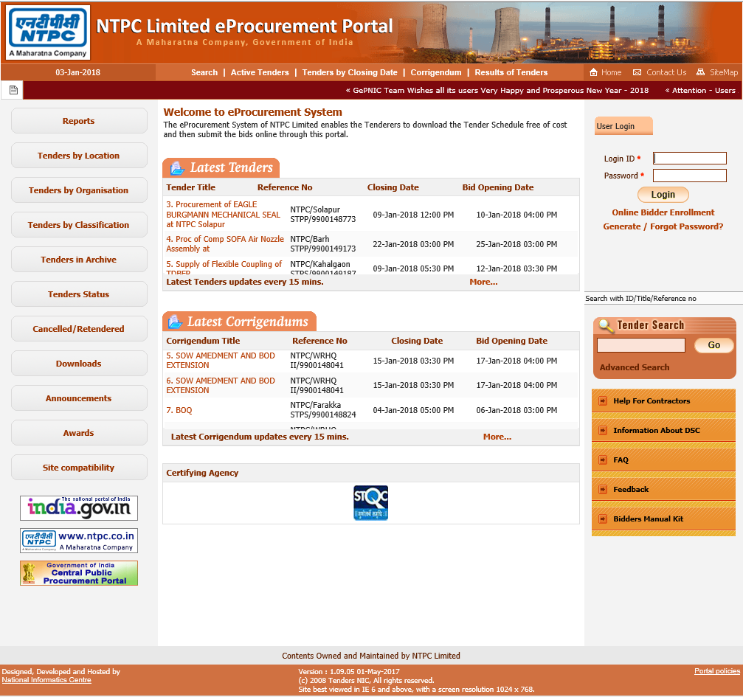
Integration of GePNIC with SAP-ERP

Slide 12
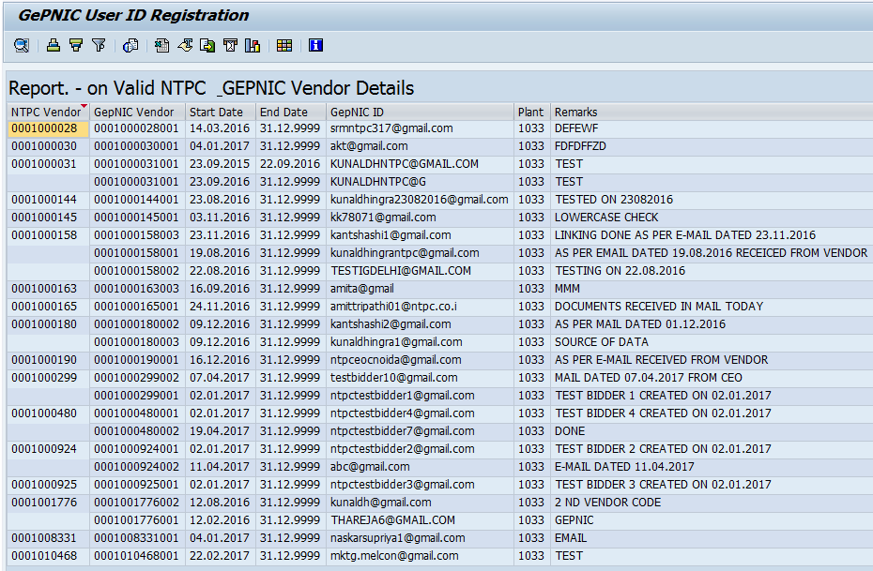
NTPC Vendor Code mapping with GePNIC User ID

Slide 13
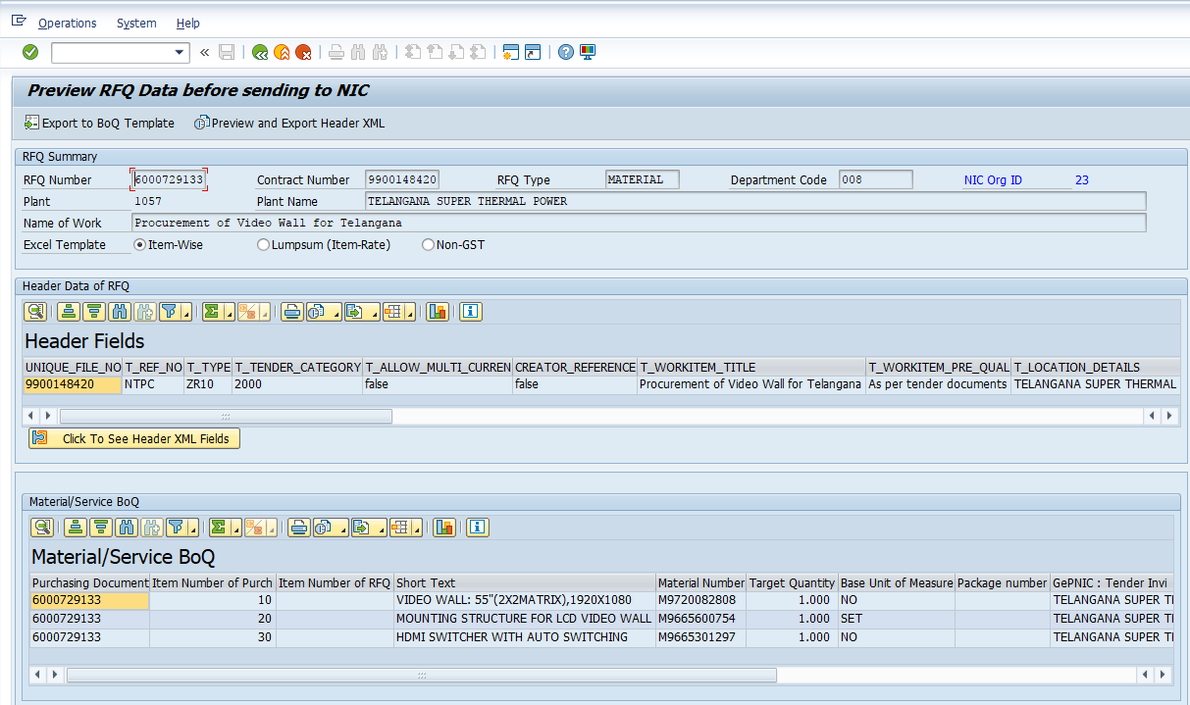
XML generation and data transfer through web service

Slide 14
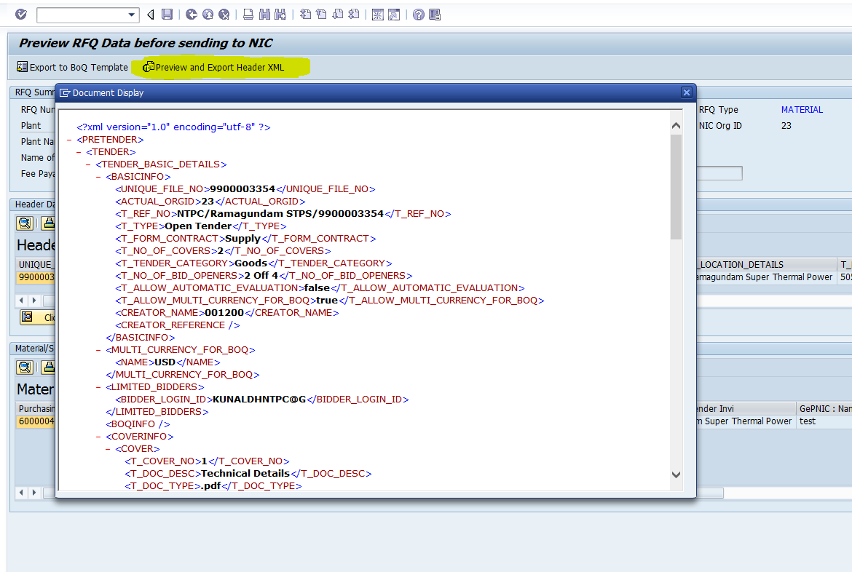
XML generation and data transfer through web service

Slide 15
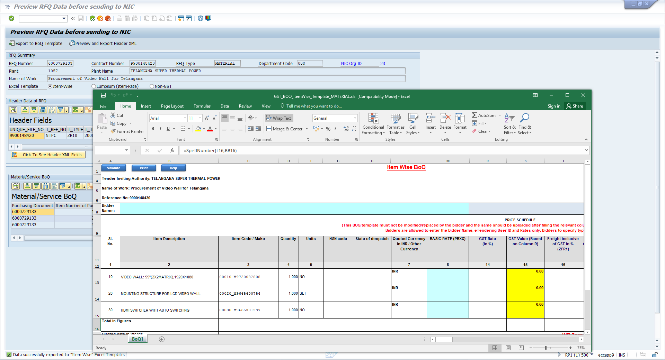
GePNIC BOQ Template generation

Slide 16
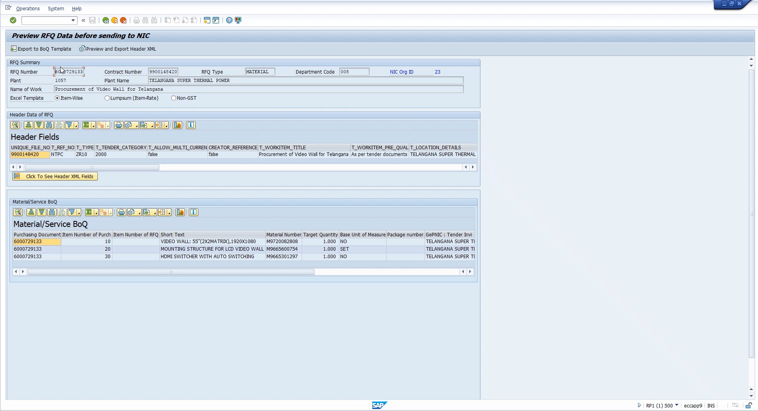
GePNIC BOQ Template generation

Slide 17
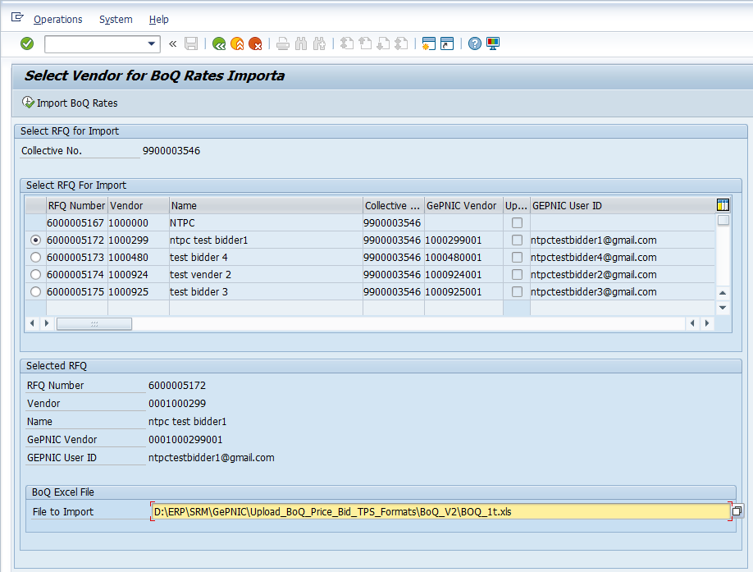
Import of quoted rates from GePNIC BOQ to ERP RFQ
Tender reference number
Vendor code & GePNIC User ID
Source file

Slide 18
AGENDA
NTPC at a Glance
e-Procurement in NTPC
Transition to GePNIC
Integration of GePNIC with SAP-ERP
Journey so far & road ahead
Suggestions for further enhancement

Slide 19
Journey so far and road ahead
  Setting up handshaking mechanism between ERP & NIC
  Development at NTPC and NIC end for data transfer
  Roll-out at pilot locations. Making minor changes based on feedback from pilot locations.
  GePNIC implemented at 51 tendering offices out of 56.
  Approx. 1000 tenders published so far. More than 7000 bidders registered on the new portal.
  Complete shifting to GePNIC planned by end of January 2018
  Activities planned:
      Starting reverse auction on GePNIC
      Roll out of online tender fee/EMD payment facility
      Import of data from GePNIC to ERP through web service

Slide 20
AGENDA
NTPC at a Glance
e-Procurement in NTPC
Transition to GePNIC
Integration of GePNIC with SAP-ERP
Journey so far & road ahead
Suggestions for further enhancement

Slide 21
Suggestions for further enhancement
  Sometimes the deptt. users miss the BOQ template and publish the tender without uploading it. A warning message to be displayed if there is no document in BOQ.
  ‘Seek Clarification End Date’ is also the time by which a clarification needs to be responded to. If a bidder seeks a clarification at the last moment, it cannot be answered. It would be better to introduce another date field ‘Clarification Reply End Date’ to take care of it.
  In case any corrigendum is issued to a tender, mail/SMS message are sent to bidders who have set that tender as their ‘favourite’ irrespective of the tender being ST/LT/OT case. In case of ST/LT tenders, notification should be sent to all selected bidders.

Slide 22
Suggestions for further enhancement
  NIT tab may be done away with as the tender documents are now freely available to be downloaded and a bidder need not go through the NIT first to decide whether to purchase the tender documents or not.
  2-stage bidding needs to be configured in GePNIC
  In the report ‘Tender Details in Excel’, a column indicating the tender type (ST/LT/OT) needs to be added.
  In a number of reports, time span for which report is generated is 1 week/1 month. It needs to be increased.

Slide 23
Suggestions for further enhancement
  In reverse auction presently own rank is not displayed to the bidders. Bidders must be aware about their own rank as sometimes the tender conditions talk about split order between the top 2 or 3 bidders.
  In reverse auction a bidder can reduce the rate only in multiples of the Decrement value. A bidder should be allowed to reduce the rate by any value more than the Decrement value as it will result in substantial savings to the purchasing deptt.
  Loading factor (adder/multiplier) provision against each bidder needs to be made in reverse auction which can be used as per the need

Slide 24

Thank You

